Slide 1
Systems Design, Privacy and Ethical Issues
Information Systems 622
IS622, chapter 6
Mr N. Mathenjwa

Slide 2
Learning Objectives
State the purpose of systems design and discuss the differences between logical and physical systems design.
Describe some considerations in design modelling and diagrams used during object oriented design.
List the advantages and disadvantages of purchasing versus developing software
Discuss the software development process and some of the tools used in this process, including object oriented program development tools.
Describe the systems review process.

Slide 3
1.1 Introduction
The previous chapter talked about how problems are analyzed. This chapter looks at how this analysis can be used to design and build IT solutions. The chapter mainly looks at developing a new system but also examines solving a problem by buying an existing information system that has already been developed.
Information systems are used in every industry and almost every career. A manager at a hotel chain can use an information system to look up client preferences. An accountant at a manufacturing company can use an information system to analyze the costs of a new plant.

Slide 4
6.1 Systems Design
The purpose of systems design is to answer the question ‘how will the information system solve the problem?’ The primary result of the systems design phase is a technical design that details system inputs and the processing required to produce outputs, user interfaces, hardware, software, databases, telecommunications, personnel and procedures, and shows how these components are related.

Slide 5
6.1 Systems Design
Two key aspects of systems design are logical and physical design.
The logical design refers to what the system will do.
Logical design describes the functional requirements of a system. That is, it conceptualizes what the system will do to solve the problems identified through earlier analysis. (use case diagram)
The physical design refers to how the tasks are accomplished, including how the components work together and what each component does. Physical design specifies the characteristics of the system components necessary to put the logical design into action. (DFD)

Slide 6
Interface Design and Controls
Some special system characteristics should be considered during both logical and physical design. These characteristics relate to how users access and interact with the system.
For example, with a menu-driven system users simply pick what they want to do from a list of alternatives.

Slide 7
Interface Design and Controls
An alternative is a command line interface which involve users typing commands at a prompt.

Slide 8
Design of System Security and Controls
In addition to considering the system’s interface and user interactions, designers must also develop system security and controls for all aspects of the system, including hardware, software, database systems, and telecommunications and Internet operations. These key considerations involve error prevention, detection and correction; system controls; and disaster planning and recovery.

Slide 9
Design of System Security and Controls
Table 6.1 The Elements of Good Interactive Dialogue

Slide 10
Design of System Security and Controls
Error Prevention, Detection and Correction
A new information system can be designed to check for certain errors itself. When users input values, the system can check that the values entered make sense and if not the user is alerted.
Disaster Planning and Recovery
Disaster planning is the process of anticipating and providing for disasters. A disaster can be an act of nature (a flood, fire or earthquake) or a human act (terrorism, error or a deliberate sabotage by a disgruntled employee). Disaster planning often focuses primarily on two issues: maintaining the integrity of corporate information, and keeping the information system running until normal operations can be resumed.

Slide 11
Design of System Security and Controls
Disaster Planning and Recovery cont..
For example, hot and cold sites can be used to back-up hardware and software.
A hot site is a space, usually some distance away from the main operation, where spare computers with the appropriate telecommunication links are set up and software installed, along with any associated peripherals such as printers, in case some problem occurs to disrupt the technology in the main location.
Another approach is to use a cold site, also called a shell, which is a computer environment that includes rooms, electrical service, telecommunication links but no hardware. If a primary computer has a problem, back-up computer hard- ware is brought into the cold site, and the complete system is made operational.

Slide 12
Systems Controls
Security lapses, fraud and the invasion of privacy can present disastrous problems Preventing and detecting these problems is an important part of systems design. Prevention includes the following:
Determining potential problems.
Ranking the importance of these problems.
Planning the best place and approach to prevent problems.
Deciding the best way to handle problems if they occur.

Slide 13
Generating Systems Design Alternatives
The development team will want to generate different designs. One approach is to come up with a basic, cheaper solution; or a top-of-the-range solution at the edge of what can be afforded; or a mixed solution sitting somewhere between the two. If the new system is complex, it might want to involve personnel from inside and outside the firm in generating alternative designs. If new hardware and software are to be acquired from an outside vendor, a formal request for proposal (RFP) can be made.

Slide 14
Generating Systems Design Alternatives
Request for Proposals
The RFP is an important document for many organizations involved with large, complex systems development efforts. Smaller, less complex systems often do not require an RFP. A company that is purchasing an inexpensive piece of software that will run on existing hardware, for ex- ample, might not need to go through a formal RFP process.

Slide 15
Generating Systems Design Alternatives
Request for Proposals

Slide 16
Generating Systems Design Alternatives
Financial Options
When acquiring computer systems, several choices are available, including purchase, lease or rent. Cost objectives and constraints set for the system play a significant role in the choice, as do the advantages and disadvantages of each. In addition, traditional financial tools, including net present value and internal rate of return, can be used. Table 6.2 summarizes the advantages and disadvantages of these financial options.

Slide 17
Generating Systems Design Alternatives
Evaluating and Selecting a Systems Design
The final step in systems design is to evaluate the various alternatives and select the one that will offer the best solution for organizational goals. Depending on their weight, any one of these objectives might result in the selection of one design over another. For example, financial concerns might make a company choose rental over equipment purchase.

Slide 18
Generating Systems Design Alternatives
The Preliminary Evaluation
A preliminary evaluation begins after all design proposals have been submitted. The purpose of this evaluation is to dismiss unwanted proposals. If external vendors have submitted proposals, some of them can usually be eliminated by investigating their proposals and comparing them with the original criteria.

Slide 19
Generating Systems Design Alternatives
The Final Evaluation
The final evaluation begins with a detailed investigation of the proposals offered by the remaining vendors. The vendors should be asked to make a final presentation and to fully demonstrate the system. The demonstration should be as close to actual operating conditions as possible. Applications such as payroll, inventory control and billing should be tested using a large amount of test data. After the final presentations and demonstrations have been given, the organization makes the final evaluation and selection

Slide 20
Generating Systems Design Alternatives
Point Evaluation
One of the disadvantages of cost–benefit analysis is the difficulty of determining the monetary values for all the benefits. An approach that does not employ monetary values is a point evaluation system.

Slide 21
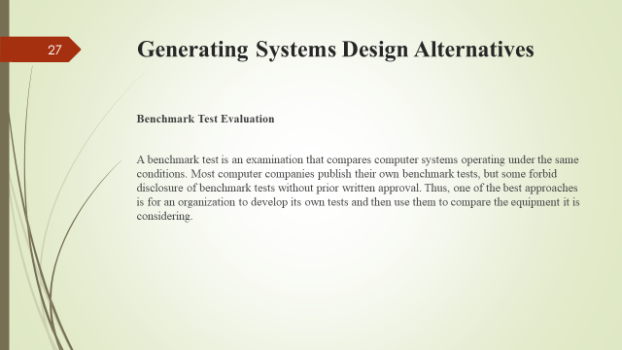

Slide 22
6.2 Systems Implementation

Slide 23
6.3 Systems Operation and Maintenance

Slide 24
6.4 Systems Review

Slide 25
6.5 Computer Waste and Mistakes

Slide 26
6.6 Computer Crime

Slide 27
6.7 Preventing Computer-Related Crime

Slide 28
https://github.com/nqubekoh/IS622
The End!!!

